Slide 1
JDBC
Advanced SQL

Slide 2
Advanced SQL
Accessing SQL From a Programming Language
Dynamic SQL
JDBC and ODBC
Embedded SQL
SQL Data Types and Schemas
Functions and Procedural Constructs
Triggers

Slide 3
JDBC and ODBC
API (application-program interface) for a program to interact with a database server
Application makes calls to
Connect with the database server
Send SQL commands to the database server
Fetch tuples of result one-by-one into program variables
ODBC (Open Database Connectivity) works with C, C++, C#, and Visual Basic
Other API’s such as ADO.NET sit on top of ODBC
JDBC (Java Database Connectivity) works with Java

Slide 4
JDBC
JDBC is a Java API for communicating with database systems supporting SQL.
JDBC supports a variety of features for querying and updating data, and for retrieving query results.
JDBC also supports metadata retrieval, such as querying about relations present in the database and the names and types of relation attributes.
Model for communicating with the database:
Open a connection
Create a “statement” object
Execute queries using the Statement object to send queries and fetch results
Exception mechanism to handle errors

Slide 5
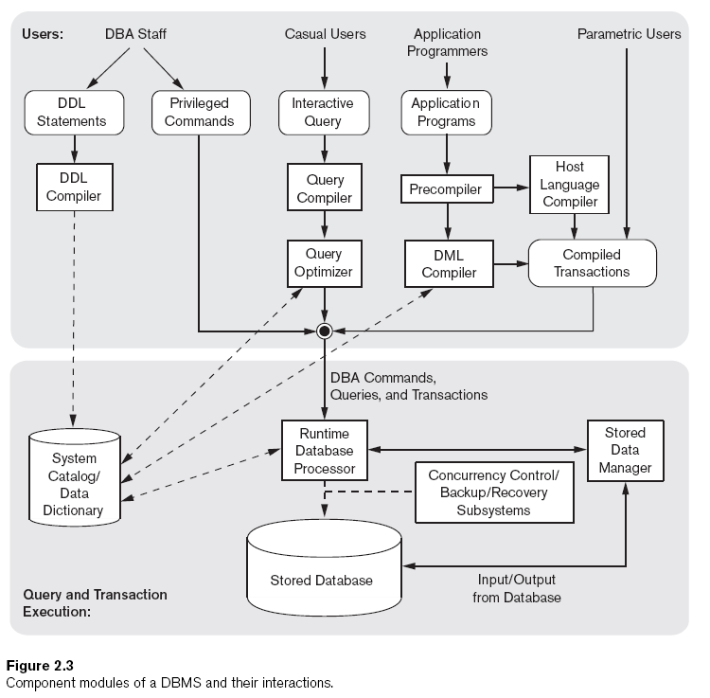

Slide 6
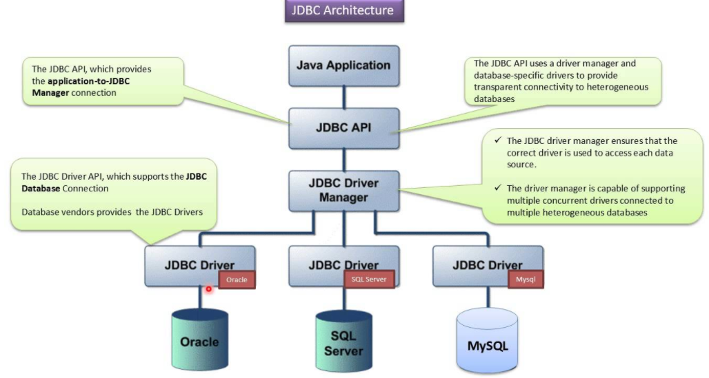
What is JDBC?
JDBC stands for Java Database Connectivity and provides a set of Java API for accessing the relational databases from Java program.
These Java APIs enables Java programs to execute SQL statements and interact with any SQL compliant database.

Slide 7
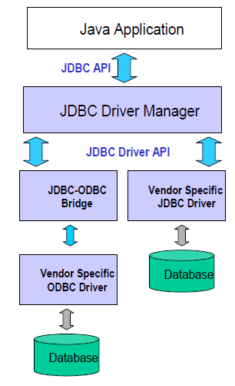
JDBC
JDBC consists of two parts:
JDBC API, a purely Java-based API
JDBC Driver Manager ,which communicates with vendor-specific drivers that perform the real communication with the database.
Point: translation to vendor format is performed on the client
No changes needed to server
Driver (translator) needed on client

Slide 8
Seven Basic Steps in using JDBC
Why JDBC?
1. Load the driver
2. Define the Connection URL
3. Establish the Connection
4. Create a Statement object
5. Execute a query
6. Process the results
7. Close the connection
to communicate with the different DBMS from JDBC, we need to use a driver to isolate the specific features of the DBMS and its communication protocol.

Slide 9
Step 1: Load the Driver
To use a JDBC driver, we must first register it in the JDBC DriverManager.
This is usually done by loading the driver class using the forName method of the class called Class.
try {
Class.forName("com.mysql.jdbc.Driver");
Class.forName("oracle.jdbc.driver.OracleDriver");
} catch (ClassNotFoundException cnfe) {
System.out.println("Error loading driver: " + cnfe);
}

Slide 10
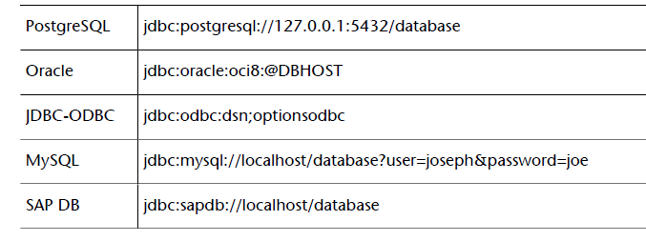
Step 2: Define the Connection URL
To identify a given connection to a database, DBMS use a URL (Universal Resource Locator) address format. This address usually takes the form:
jdbc:driver:database

Slide 11
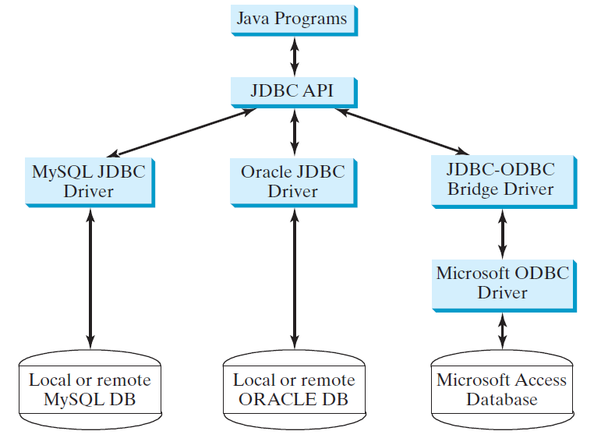
The Architecture of JDBC

Slide 12
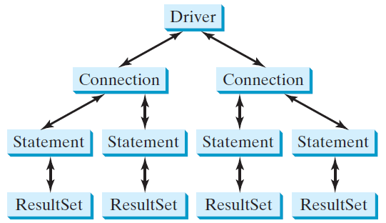
The JDBC Interfaces
Loading drivers
Establishing connections
Creating and executing statements
Processing ResultSet

Slide 13
Developing JDBC Programs
Loading drivers
Establishing connections
Creating and executing statements
Processing ResultSet
Statement to load a driver:
Class.forName("JDBCDriverClass");
A driver is a class. For example:
Database Driver Class Source
Access sun.jdbc.odbc.JdbcOdbcDriver Already in JDK
MySQL com.mysql.jdbc.Driver Website
Oracle oracle.jdbc.driver.OracleDriver Website
The JDBC-ODBC driver for Access is bundled in JDK.
MySQL driver class is in mysqljdbc.jar
Oracle driver class is in classes12.jar
To use the MySQL and Oracle drivers, you have to add mysqljdbc.jar and classes12.jar in the classpath using the following DOS command on Windows:
classpath=%classpath%;c:\book\mysqljdbc.jar;c:\book\classes12.jar

Slide 14
Developing JDBC Programs
Loading drivers
Establishing connections
Creating and executing statements
Processing ResultSet
Connection connection = DriverManager.getConnection(databaseURL);
Database URL Pattern
Access jdbc:odbc:dataSource
MySQL jdbc:mysql://hostname/dbname
Oracle jdbc:oracle:thin:@hostname:port#:oracleDBSID
Examples:
For Access:
Connection connection = DriverManager.getConnection
("jdbc:odbc:ExampleMDBDataSource");
For MySQL:
Connection connection = DriverManager.getConnection
("jdbc:mysql://localhost/test");
For Oracle:
Connection connection = DriverManager.getConnection
("jdbc:oracle:thin:@liang.armstrong.edu:1521:orcl", "scott", "tiger");

Slide 15
Developing JDBC Programs
Loading drivers
Establishing connections
Creating and executing statements
Processing ResultSet
Creating statement:
Statement statement = connection.createStatement();
Executing statement (for update, delete, insert):
statement.executeUpdate
("create table Temp (col1 char(5), col2 char(5))");
Executing statement (for select):
// Select the columns from the Student table
ResultSet resultSet = statement.executeQuery
("select firstName, mi, lastName from Student where lastName "
+ " = 'Smith'");

Slide 16
Developing JDBC Programs
Loading drivers
Establishing connections
Creating and executing statements
Processing ResultSet
Executing statement (for select):
// Select the columns from the Student table
ResultSet resultSet = stmt.executeQuery
("select firstName, mi, lastName from Student where lastName "
+ " = 'Smith'");
Processing ResultSet (for select):
// Iterate through the result and print the student names
while (resultSet.next())
System.out.println(resultSet.getString(1) + " " + resultSet.getString(2)
+ ". " + resultSet.getString(3));

Slide 17
Simple JDBC Example
import java.sql.*;
public class SimpleJdbc {
public static void main(String[] args)
throws SQLException, ClassNotFoundException {
// Load the JDBC driver
Class.forName("com.mysql.jdbc.Driver");
System.out.println("Driver loaded");
// Establish a connection
Connection connection = DriverManager.getConnection
("jdbc:mysql://localhost/test");
System.out.println("Database connected");
// Create a statement
Statement statement = connection.createStatement();
// Execute a statement
ResultSet resultSet = statement.executeQuery
("select firstName, mi, lastName from Student where lastName "
+ " = 'Smith'");
// Iterate through the result and print the student names
while (resultSet.next())
System.out.println(resultSet.getString(1) + "\t" +
resultSet.getString(2) + "\t" + resultSet.getString(3));
// Close the connection
connection.close();
}
}

Slide 18
JDBC Code
public static void JDBCexample(String dbid, String userid, String passwd)
{
try {
Class.forName ("oracle.jdbc.driver.OracleDriver");
Connection conn = DriverManager.getConnection( "jdbc:oracle:thin:@db.yale.edu:2000:univdb", userid, passwd);
Statement stmt = conn.createStatement();
… Do Actual Work ….
stmt.close();
conn.close();
}
catch (SQLException sqle) {
System.out.println("SQLException : " + sqle);
}
}

Slide 19
JDBC Code (Cont.)
Update to database
try { stmt.executeUpdate ( "insert into instructor values(’77987’, ’Kim’, ’Physics’, 98000)"); } catch (SQLException sqle) { System.out.println("Could not insert tuple. " + sqle); }
Execute query and fetch and print results
ResultSet rset = stmt.executeQuery ( "select dept_name, avg (salary) from instructor group by dept_name"); while (rset.next()) { System.out.println(rset.getString("dept_name") + " " + rset.getFloat(2)); }

Slide 20
JDBC Code Details
Getting result fields:
rs.getString(“dept_name”) and rs.getString(1) equivalent if dept_name is the first argument of select result.
Dealing with Null values
int a = rs.getInt(“a”);
if (rs.wasNull()) Systems.out.println(“Got null value”);

Slide 21
Prepared Statement
PreparedStatement pStmt = conn.prepareStatement( "insert into instructor values(?,?,?,?)"); pStmt.setString(1, "88877"); pStmt.setString(2, "Perry"); pStmt.setString(3, "Finance"); pStmt.setInt(4, 125000); pStmt.executeUpdate(); pStmt.setString(1, "88878"); pStmt.executeUpdate();
For queries, use pStmt.executeQuery(), which returns a ResultSet
WARNING: always use prepared statements when taking an input from the user and adding it to a query
NEVER create a query by concatenating strings which you get as inputs
"insert into instructor values(’ " + ID + " ’, ’ " + name + " ’, " + " ’ + dept_name + " ’, " ’ balance + ")“
What if name is “D’Souza”?

Slide 22
SQL Injection
Suppose query is constructed using
"select * from instructor where name = ’" + name + "’"
Suppose the user, instead of entering a name, enters:
X’ or ’Y’ = ’Y
then the resulting statement becomes:
"select * from instructor where name = ’" + "X’ or ’Y’ = ’Y" + "’"
which is:
select * from instructor where name = ’X’ or ’Y’ = ’Y’
User could have even used
X’; update instructor set salary = salary + 10000; --
Prepared statement internally uses:
Always use prepared statements, with user inputs as parameters

Slide 23
Example JDBC

Slide 24
ODBC – C Language
char deptname[80]; float salary; int lenOut1, lenOut2; HSTMT stmt; char * sqlquery = "select dept_name, sum (salary) from instructor group by dept_name"; SQLAllocStmt(conn, &stmt); error = SQLExecDirect(stmt, sqlquery, SQL_NTS); if (error == SQL SUCCESS) { SQLBindCol(stmt, 1, SQL_C_CHAR, deptname , 80, &lenOut1); SQLBindCol(stmt, 2, SQL_C_FLOAT, &salary, 0 , &lenOut2); while (SQLFetch(stmt) == SQL_SUCCESS) { printf (" %s %g\n", deptname, salary); } } SQLFreeStmt(stmt, SQL_DROP);

Slide 25
ADO.NET
API designed for Visual Basic .NET and C#, providing database access facilities similar to JDBC/ODBC
Partial example of ADO.NET code in C# using System, System.Data, System.Data.SqlClient; SqlConnection conn = new SqlConnection( “Data Source=<IPaddr>, Initial Catalog=<Catalog>”); conn.Open(); SqlCommand cmd = new SqlCommand(“select * from students”, conn); SqlDataReader rdr = cmd.ExecuteReader(); while(rdr.Read()) { Console.WriteLine(rdr[0], rdr[1]); /* Prints result attributes 1 & 2 */ } rdr.Close(); conn.Close();
Can also access non-relational data sources such as
OLE-DB, XML data, Entity framework

